Slide 1
Spectral clustering
Spectral clustering is a machine learning technique used for clustering data points into groups based on the similarity between data points.
It's particularly effective at identifying clusters in data with complex structures, including non-convex and irregularly shaped clusters.
Spectral clustering operates on a similarity or affinity matrix derived from the data and utilizes techniques from linear algebra and graph theory.
Spectral clustering performs a low-dimension embedding of the affinity matrix between samples, followed by clustering, e.g., by KMeans, of the components of the eigenvectors in the low dimensional space.

Slide 2
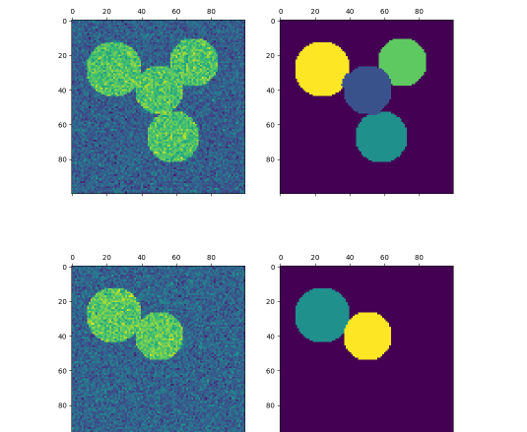
Spectral clustering diagram

Slide 3
The present version of SpectralClustering requires the number of clusters to be specified in advance. It works well for a small number of clusters, but is not advised for many clusters.
Spectral clustering is widely used in various domains, including image segmentation, community detection in social networks, and dimensionality reduction for high-dimensional data.
Its ability to capture complex relationships between data points makes it a valuable tool for exploratory data analysis and unsupervised learning tasks.

